Slide 1

Sentiment Analysis on Restaurant Reviews
Subtitle: Using TextBlob-based Sentiment Classification Presented by: Syed Shahid Organization: SLASH MARK IT Solutions Date: 29/05/2025
SS

Slide 2
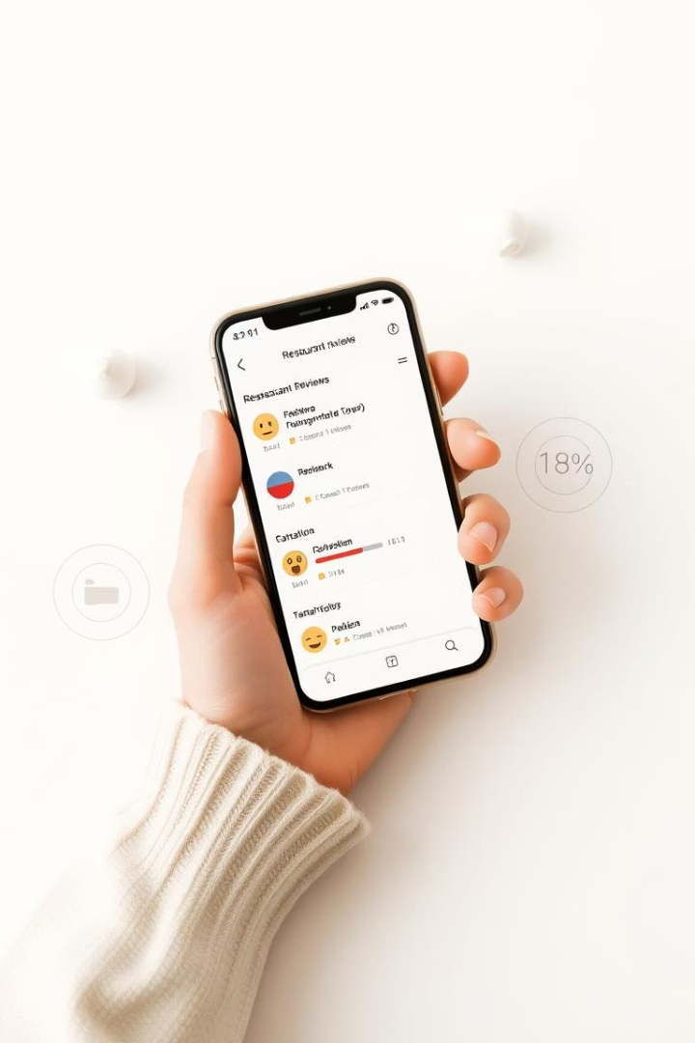
Slide 1: Introduction
Sentiment analysis finds emotional tone in customer reviews
Helps businesses understand public opinion fast
Project uses TextBlob, a rule-based NLP tool

Slide 3
Slide 2: Objective & Background
Objective:
Background:
Classify restaurant reviews as Positive, Negative, or Neutral
Manual review analysis is time-consuming
Sentiment analysis helps automate this process

Slide 4
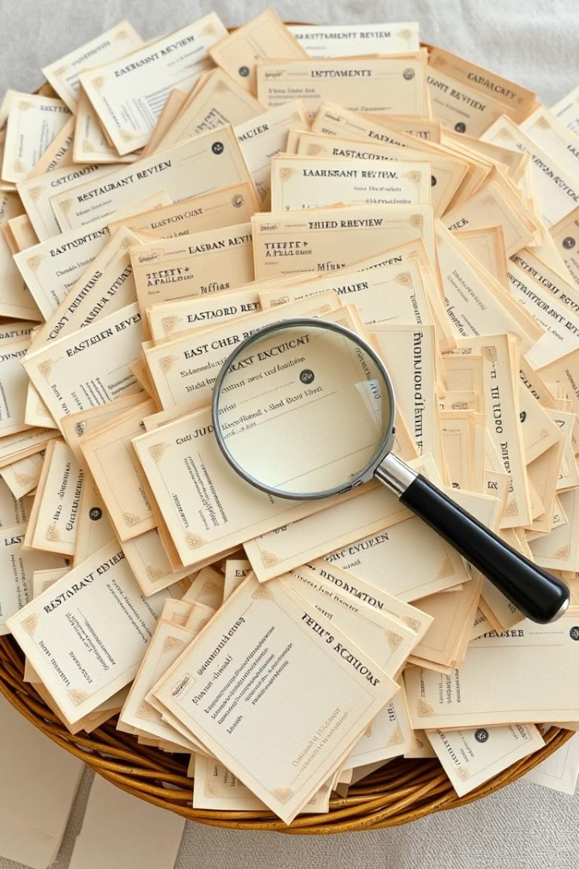



Slide 3: Problem Statement
Restaurants receive huge numbers of reviews
Human reading is inefficient
Need a simple, fast, automatic tool to classify reviews

Slide 5
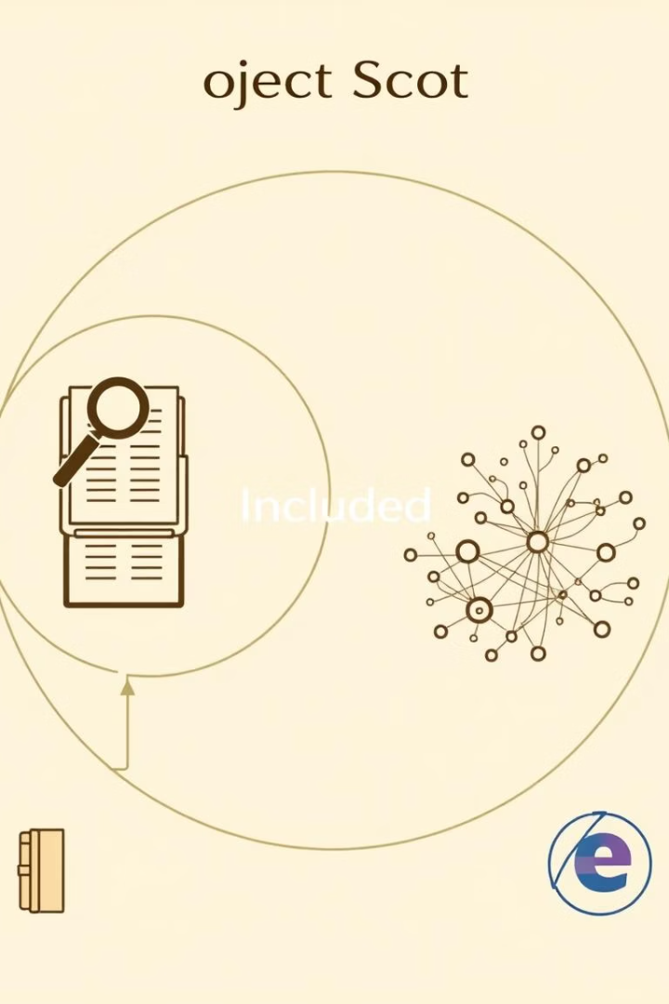
Slide 4: Project Scope
Included:
Excluded:
English text analysis
Machine learning models
TextBlob for sentiment detection
Web scraping or UI dashboard
Rule-based classification
Constraints:
Input must be in English
Accuracy may vary for ambiguous sentences

Slide 6




Slide 5: Methodology
User inputs review text
Text is converted to lowercase
TextBlob returns polarity score
Score is interpreted into sentiment
Tools Used:
Google Colab
Python
TextBlob
Pandas (optional)

Slide 7
Slide 6: Sentiment Pipeline (Diagram)
[Input Text]
[Text Cleaning]
[TextBlob Analysis]
[Polarity Score]
[Final Sentiment Output]

Slide 8
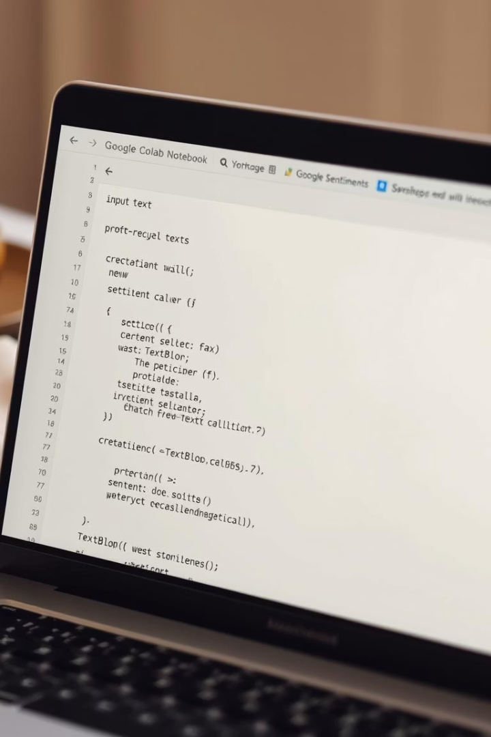
Slide 7: Code Snippet (Colab)
from textblob import TextBlobtext = "The food was amazing!"blob = TextBlob(text)polarity = blob.sentiment.polaritysentiment = "Positive" if polarity > 0 else "Negative" if polarity < 0 else "Neutral"print("Sentiment:", sentiment)

Slide 9
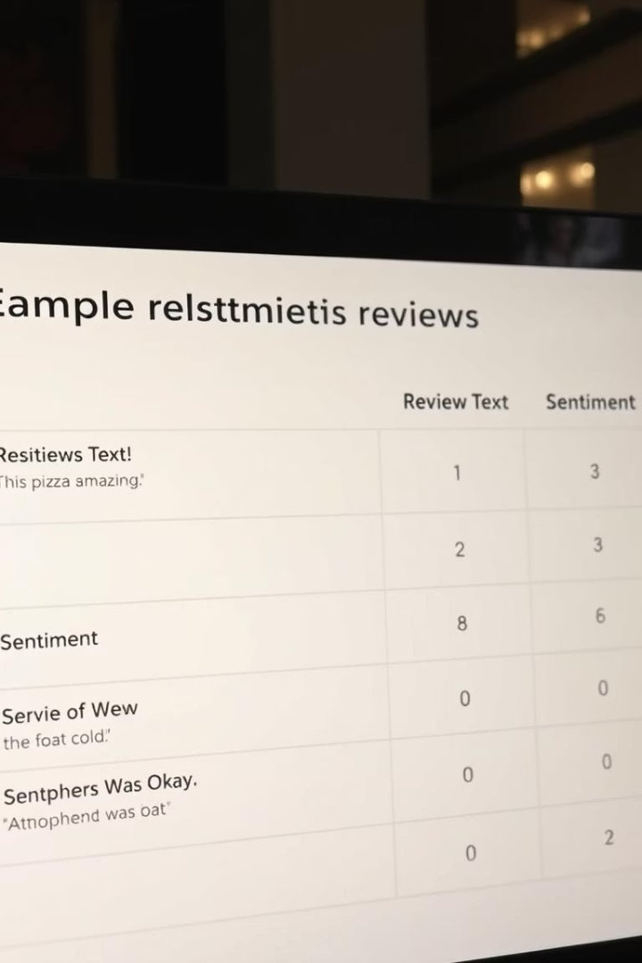
Slide 8: Testing & Examples
Review
Sentiment
"Food was delicious!"
Positive
"Worst experience ever."
Negative
"It was okay."
Neutral

Slide 10




Slide 9: Results & Insights
Works well on clear English reviews
Captures overall emotion via polarity score
No ML model needed = very fast

Slide 12

Challenges
Confusing sentences (e.g., "Food was good but service was bad")
No training model = can't learn from mistakes
Mixed languages not supported

Slide 13
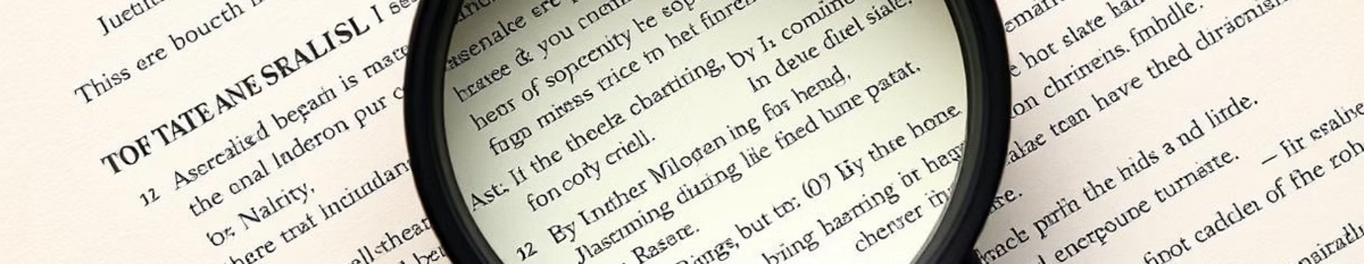
Conclusion
Project shows that TextBlob can analyze review sentiment
Simple and effective for small datasets
Useful for beginners in NLP

Slide 14


Future Scope
Support for multi-language reviews
Add Neutral detection confidence
Deploy on website using Flask
Compare with VADER or ML models

Slide 15

Contact and GitHub
Email:
GitHub:
syedshahid7650@gmail.com
github.com/shahid8907503/Sentiment-Analysis1

